Slide 1
Pulmonary manifestations of HIV
Marjan Hemmatian M.D
Assistant Professor of Infectious Diseases, Shahid Beheshti University of Medical Sciences.
HIV/AIDS Fellowship

Slide 2
HIV infection increases the risk of infectious and noninfectious respiratory diseases, and these diseases are often the sentinel event that brings a person with previously undiagnosed HIV infection to medical attention.

Slide 3
The use of combination ART has dramatically diminished the incidence of all these complications.
Even among individuals with normal or near-normal CD4 cell counts who are on ART, the rate of bacterial pneumonia is significantly higher among those with HIV than in uninfected(10-fold higher).
Treatment with TMP-SMX, has been shown to increase the rate of colonization with resistant bacteria, especially pneumococci.

Slide 4
Differential Diagnosis of Respiratory Symptoms in a Person with HIV Infection
Clinical or Laboratory Stage of Immunosuppression.
Tempo of the Illness.
Receipt and type of Pneumocystis prophylaxis should be evaluated.
Receipt of Antiretroviral Therapy.
History of Opportunistic Processes.
Injection Drug Use and Smoking.
Local Epidemiology or Past Residence.
Characteristic Radiographic Findings

Slide 5
Community-Acquired Pneumonia
Recurrent pneumonia, considered two or more episodes within a 1-year period, is an AIDS-defining condition.
Streptococcus pneumoniae and Hemophilus species .
Atypical bacterial pathogens infrequent causes of CAP in individuals with HIV.
S. pneumoniae and Staphylococcus aureus are among the most common etiologies of pneumonia in association with influenza infection.
Influenza and COVID-19 generally present similarly in people with and without HIV, some studies suggest: mortality may be increased among people with HIV for these viral infections, particularly in low-and-middle income country settings.

Slide 6
Community-Acquired Pneumonia
Risk Factors for P. Aeruginosa and S. aureus .
Clinical and Radiographic Presentation.
Treatment
Duration of Therapy(5–7 days).
Pneumococcal Vaccination: All people with HIV regardless of CD4 count .
Influenza Vaccination: All people with HIV infection during influenza season, regardless of CD4count
Adults age ≥65 years are recommended to receive high-dose IIV or adjuvanted IIV.
COVID-19 Vaccination
The incidence of H. influenzae type b infection in adults with HIV is low. Therefore, H. influenzae type vaccine is not usually recommended for adult use

Slide 7
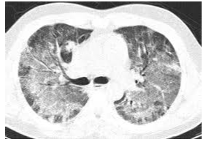
Pneumocystis Pneumonia
Clinical Manifestations: subacute onset of progressive dyspnea, non-productive cough, Hypoxemia, LDH>500 mg/dL .
Diagnosis: Induced sputum ,BAL.
Treatment: Pcp treatment can be initiated before a definitive diagnosis is established because P. jirovecii persist in clinical specimens for days or weeks after effective therapy is initiated.
TMP-SMX(treatment and prophylaxis)
Primaquine30 mg (base) PO daily plus Clindamycin PO (450 mg every 6 hours or 600 mg every 8 hours)
capofungine

Slide 8
Mycobacterium tuberculosis Infection and Disease
Even with effective ART, the risk of TB disease among people with HIV remains greater than that among the general population.
The estimated annual risk of developing TB disease among people with LTBI (diagnosed by a positive tuberculin skin test [TST] or interferon-gamma release assay [IGRA] in the absence of a TB disease diagnosis) is 3 to 12 times greater for people with untreated HIV than for those without HIV.
The routine use of both TST and IGRAs in a single patient to screen for LTBI is not recommended.

Slide 9
Mycobacterium tuberculosis Infection and Disease
All people with HIV should be evaluated for LTBI at the time of HIV diagnosis, regardless of their epidemiological risk of TB exposure(IGRA ,TST).
People with advanced HIV (CD4 count <200 cells/mm3) and negative diagnostic tests for LTBI, and no indications for initiating empiric LTBI treatment (i.e., no recent exposure to a culture-confirmed TB case) should be retested for LTBI once they start ART and attain a CD4 count ≥200 cells/mm3 to ensure that the initial test result was a true negative result.
Annual testing for LTBI using TST or IGRA is recommended.

Slide 10
Recommendations for Treating LTBI to Prevent TB Disease in People with HIV
Positive screening test for LTBI (≥5 mm of induration at 48–72 hours in people with HIV or positive IGRA) regardless of BCG status, no evidence of active TB disease, and no prior history of treatment for active disease or latent TB infection.
Close contact with a person with infectious TB such as someone who has shared air space, such as in a household or close congregate setting, with a person with active pulmonary TB regardless of screening test result and CD4 count .
Presence of fibrotic lesions in the apex of the lung on chest radiography

Slide 11
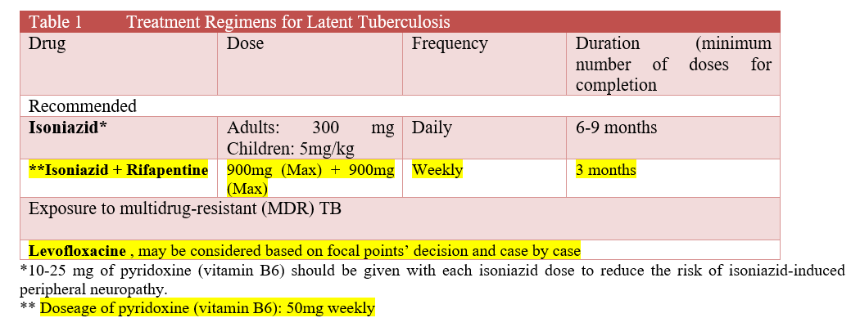

Slide 12
Mycobacterium tuberculosis Infection and Disease
The presentation of TB disease is influenced by the degree of immunodeficiency.
With increasing degrees of immunodeficiency, extrapulmonary (especially lymphadenitis, pleuritis, pericarditis, and meningitis) or disseminated TB are more common.
In people with HIV who are markedly immune-suppressed, TB can be a severe systemic disease with high fevers, rapid progression, and features of sepsis.

Slide 13
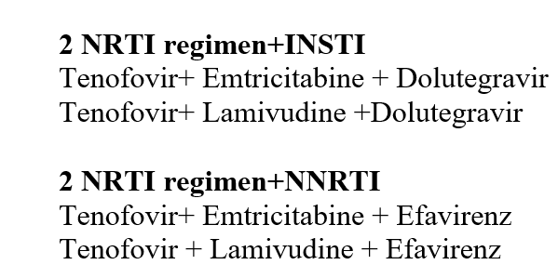
Mycobacterium tuberculosis Infection and Disease
Treatment(6-9 m HREZ).
Interaction.

Slide 14
Disseminated Mycobacterium avium Complex Disease
NTM:M. avium subspecies hominissuis and M. colombiense and other non-MAC species, including M. genavense, M. kansasii, M. simiae, M. mycogenicum
MAC disease typically occurs in people with HIV with CD4 T lymphocyte (CD4) cell counts <50 cells/mm3.
Incidence of MAC disease among people with HIV has declined substantially in the modern ART era .
A confirmed diagnosis of disseminated MAC disease is based on compatible clinical signs and symptoms coupled with the isolation of MAC from cultures of blood, lymph fluid, bone marrow, or other normally sterile tissue or body fluids.

Slide 15
Primary prophylaxis is not recommended for adults and adolescents who immediately initiate ART
CD4 count <50 cells/mm3 AND not receiving ART or remains viremic on ART or has no options for a fully suppressive ART regimen.
Before primary prophylaxis is initiated, disseminated MAC disease should be ruled out by clinical assessment, and if appropriate, by obtaining a blood culture for MAC . If blood culture is obtained, prophylaxis should be delayed until results are available to avoid exposing patients to monotherapy and the attendant risk of drug resistance .
Preferred Therapy
Azithromycin 1,200 mg PO once weekly , or
Clarithromycin 500 mg PO twice daily , or
Azithromycin 600 mg PO twice weekly .

Slide 16
Cytomegalovirus pneumonitis.
Cryptococcal pneumonia.
Pulmonary toxoplasmosis.

Slide 17
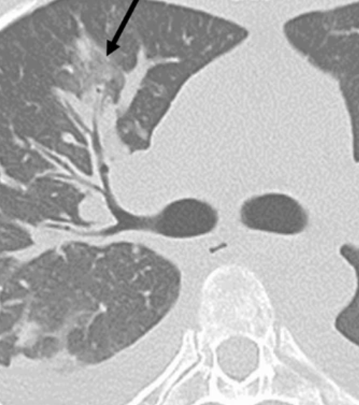
Pulmonary neoplasms in HIV patients:
Pulmonary KS :Cutaneous or mucosal disease+ peribronchovascular(flame shaped) distribution of infiltration +/- pulmonary effusions +direct visualization of characteristic purplish plaques on bronchoscopy.
Treatment: ART+/-liposomal doxorubicin

Slide 18
Pulmonary neoplasms in HIV patients
pulmonary lymphoma.
PEL
Lung cancer(smokers having the greatest risk).
Lymphocytic interstitial pneumonitis(LIP):preserved or even normal CD4.

Slide 19
Pulmonary hypertension
HIV infection is a risk factor for the development of pulmonary hypertension.(5.6%-13%)
It occurs at all stages of HIV disease, with variable CD4 cell counts and HIV RNA levels at the time of presentation.
Symptom :exertional dyspnea; cough, fatigue, and chest pain may also be present.
Echocardiography: shows evidence of right atrial hypertrophy and elevated pulmonary pressures; this is then confirmed with right heart catheterization.
Treatment: Prostaglandin agonists ( epoprostenol), endothelin receptor antagonists (bosentan, ambrisentan), diuretics, and anticoagulation . sildenafil may also have a role, but clinicians should be cautious about drug interactions with some antiretroviral agents.
Studies have not consistently shown a beneficial response to ART.

Slide 20
Abacavir
1 to 6 weeks of starting the drug cough and dyspnea may occur, along with fever, rash, fatigue, malaise, gastrointestinal symptoms, and arthralgias. Symptoms generally resolve slowly after cessation of the drug. rechallenge can lead to an immediate and life-threatening recurrence Because abacavir hypersensitivity can mimic A strong association is seen between the presence of the human leukocyte antigen (HLA)-B 5701

Slide 21
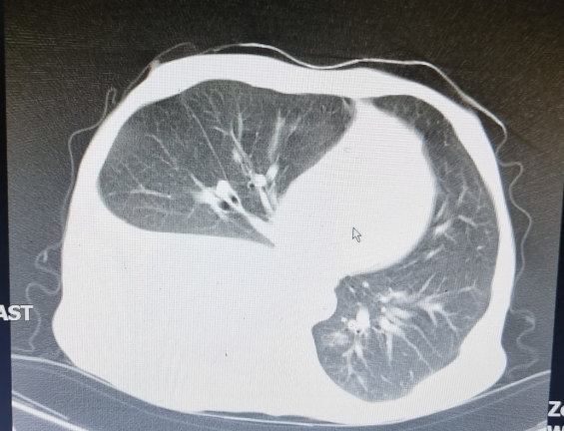
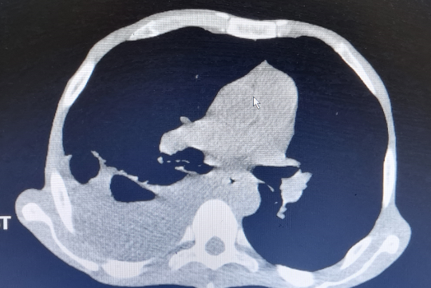
A 35 years old man. Smoker +, IDU +. He was hospitalized with fever, chills, weakness and dyspnea started 4days before. PH/EX: Decrease in sound in the right lung.

Slide 22
PMH
Three months ago, the patient developed cough, sputum, and dyspnea, and in the examinations, he had oral candidiasis, generalized lymphadenopathy, and splenomegaly
In the CT scan of the lungs, he had a tree-in-bud appearance.
Multiple lymph nodes with a necrotic and sometimes conglomerated appearance in the, Porta hepatis, Para pancreatic and para-aorta have been found in the CT scan of the abdomen
The HIV test will be checked which is reported to be HIV-positive .
Anti-tuberculosis was started.
sputum smear for acid fast bacillus=Negative

Slide 23
Lab test
Wbc=3100 HB=7 plt=100000 cr=0/7 Esr=43 Crp=150 Ast=52 Alt=20 Alkp=371 CD4=16 PPD=0

Slide 24
Pleural fluid analysis
SMEAR FOR AFB=POSITIVE
GeneXpert=Negative
Milky
Glucose=119
Protein=3100
LDH=419
WBC=120(PMN=85%.LYMPH=15%)
RBC=1760
ALB=1500
ADA=16
TG=146
CHOL=23

Slide 25
Based on the pleural fluid results, what is the diagnosis? Causes ?

Slide 26
Chylothorax Culture
Mycobacterium simiae

Slide 27
M. simiae: slowly growing nontuberculous mycobacteria. M. simiae was originally isolated from rhesus monkeys and later from tap water. its limited pathogenicity, it mainly produces lung infection in immunocompetent elderly patients with underlying lung disease, and in disseminated infections in immunosuppressed young patients with AIDS Fever, night sweats, weight loss, and adenopathy.

Slide 28
Treatment
M. simiae often is resistant to isoniazid, rifampin, ethambutol, and aminoglycosides in vitro.
Trimethoprim-sulfamethoxazole, quinolones, and clarithromycin may be effective.

Slide 29


